Slide 1
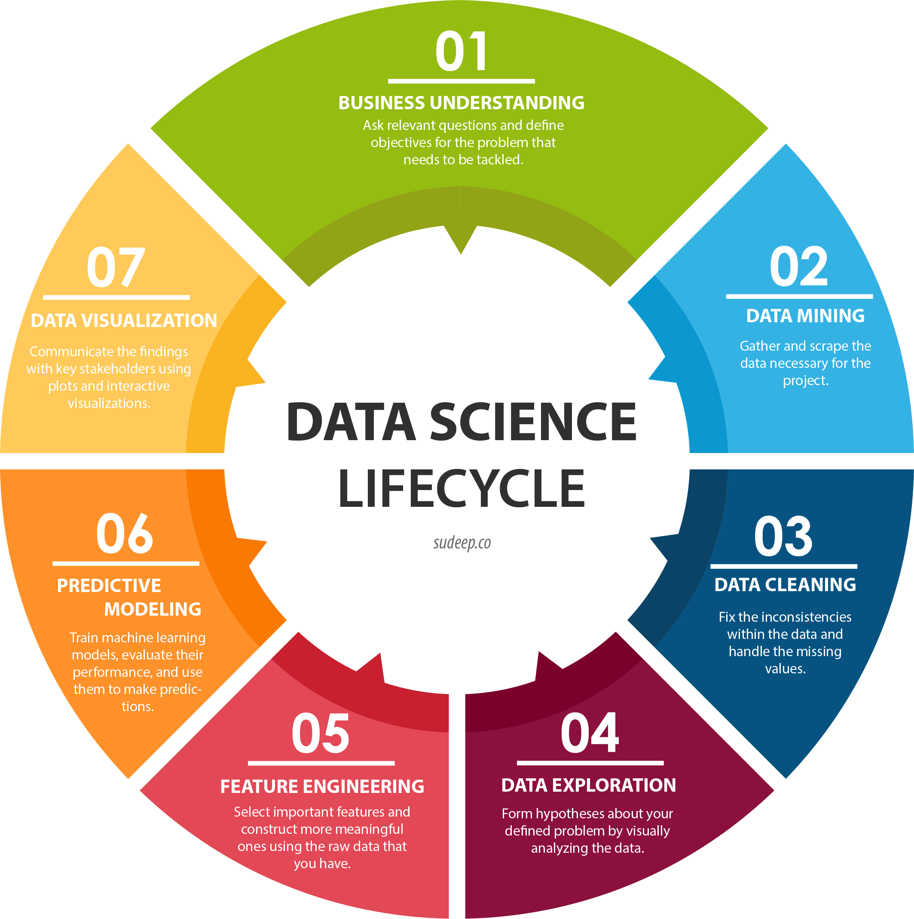
Best public data source: https://eschome.net/index.html
Country dimension context – Wikipedia et al.
Tableau story
Python data scrape
Populate excel file manually with country dimension data (Baltic, Big Five, Nordic, etc)
Did not do this step – next time!
Python:
Find and replace nulls
Convert floats to integers
Python:
Calculate adjusted order values for years where there aren’t exactly 26 entries
Python:
Look for patterns in bloc voting

